Slide 1
Social Work Doctoral Education
Click here on any slide to hear the audio

Slide 2
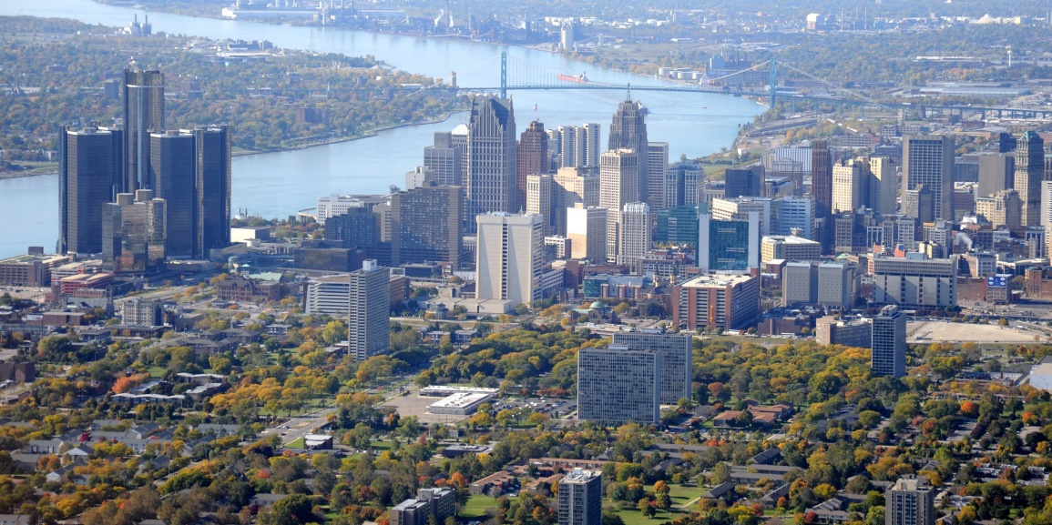
Vision Statement
A learning collaborative of talented and diverse faculty, staff and students addressing complex problems, promoting social justice and fostering overall well-being through engaged teaching, research and partnership within an urban and global context.

Slide 3
Urban Mission
Is attentive to the urban context in which social work is practiced and assessed, including understanding the needs and assets of individuals, families, organizations, and communities.
Values the diversity of the experience and expertise of individuals, neighborhoods, and groups in the urban community.
Engages in mutually beneficial collaborations in the development, implementation, and dissemination of research with individuals, groups, and organizations in urban communities.
Trains students in research methods that reflect cultural humility in engagement with individuals, neighborhoods, and groups to assess issues and develop solutions in the urban context.

Slide 4
Why Wayne State?
Flexible full- and part-time study.
Opportunities for professional and intellectual growth.
Advanced training that will enable graduates to assume positions of leadership in the social work profession locally, regionally, and nationally.
An intimate environment that combines personalized advisement and support geared toward maximizing degree completion and success with the resources of a large urban university.

Slide 5
Why Wayne State?
Opportunities to engage in mutually beneficial collaborations in the Detroit community.
Diversity of background, experiences, and areas of expertise and interest among faculty, staff, and students, which promotes exposure to multiple perspectives and issues.
Opportunities to specialize your education to your interests and goals, including interdisciplinary programs with Anthropology, Infant Mental Health and Gerontology, or to build your own specialization.

Slide 6
Doctoral & Certificate Programs
DOCTORAL AND CERTIFICATE PROGRAMS
CERTIFICATE IN RESEARCH
PH.D. PROGRAM
SOCIAL WORK AND ANTHROPOLOGY (SWAN) PH.D. PROGRAM
PHD DUAL-TITLE PROGRAMS
GERONTOLOGY
INFANT MENTAL HEALTH

Slide 7
Doctoral & Certificate Programs
DOCTORAL AND CERTIFICATE PROGRAMS
CERTIFICATE IN RESEARCH
PH.D. PROGRAM
SOCIAL WORK AND ANTHROPOLOGY (SWAN) PH.D. PROGRAM
PHD DUAL-TITLE PROGRAMS
GERONTOLOGY
INFANT MENTAL HEALTH
Strengthen research and evaluation skills
Frame evaluation or research questions
Use quantitative and qualitative tools to assess outcomes
Develop skills to translate research into practice

Slide 8
Doctoral & Certificate Programs
DOCTORAL AND CERTIFICATE PROGRAMS
CERTIFICATE IN RESEARCH
PH.D. PROGRAM
SOCIAL WORK AND ANTHROPOLOGY (SWAN) PH.D. PROGRAM
PHD DUAL-TITLE PROGRAMS
GERONTOLOGY
INFANT MENTAL HEALTH
Prepare social work scholars to assume leadership positions as social work educators, researchers, policy makers, and agency administrators
To prepare Ph.D. students as ethical, competent advanced scholars equipped to engage in research on contemporary issues and problems

Slide 9
Doctoral & Certificate Programs
DOCTORAL AND CERTIFICATE PROGRAMS
CERTIFICATE IN RESEARCH
PH.D. PROGRAM
SOCIAL WORK AND ANTHROPOLOGY (SWAN) PH.D. PROGRAM
PHD DUAL-TITLE PROGRAMS
GERONTOLOGY
INFANT MENTAL HEALTH
Prepare social work scholars with specialized training in Anthropology, Gerontology, or Infant Mental Health
Engage in interdisciplinary education and research

Slide 10
Doctoral & Certificate Programs
DOCTORAL AND CERTIFICATE PROGRAMS
CERTIFICATE IN RESEARCH
PH.D. PROGRAM
SOCIAL WORK AND ANTHROPOLOGY (SWAN) PH.D. PROGRAM
PHD DUAL-TITLE PROGRAMS
GERONTOLOGY
INFANT MENTAL HEALTH
Non-Degree Option
Explore advanced social work education
Gain experience or remediation in areas of interest or challenge
Up to 9 credits

Slide 11
Who should apply?
Applicants are:
Critical thinkers and intellectually curious
Passionate about answering important questions about critical issues.
Interested in generating and disseminating new knowledge
The doctoral program is open to highly qualified students.

Slide 12
What will you gain?
Doctoral degree graduates will gain:
Superior knowledge of their interest are in the field of Social Work
Exposure to research opportunities to practice skills in an applied setting
The ability to design and conduct independent research and evaluation of social work practice and/or social welfare policy

Slide 14
How long does it take?
PhD
(approximately 4 years)
Certificate
(up to 3 years)
Non-Degree
(up to 9 credits)

Slide 15
Curriculum
Curriculum Area | PhD | Certificate | Interdisciplinary
Research | 6 credits | 6 credits | 3 credits
Applied Research | 4 credits | 3 credits
Statistics | 6 credits | 6 credits | 6 credits
Theory | 9 credits | 3 credits | 6 credits
SW Elective | 3 credits
Cognate | 9 credits |  | 9 credits in selected program
Open Elective/Transfer | 23 credits |  | Varies by program
Dissertation | 30 credits |  | 30 credits
Total | 90 | 18 | 90

Slide 16
PhD Timeline
Courses
Full time – 4 to 5 semesters
Part time – 6 to 8 semesters
Qualifying Exam
Statistics, Theory, and Research
Dissertation
1 1/2 to 3 years
Substantive Area

Slide 17
Application Process
Typical Qualifications | PhD | Certificate | Non-Degree
Undergraduate and Graduate Transcripts | ✅ | ✅ | ✅
GRE | ✅
Written Statement of Interest | ✅ | ✅ | ✅
Writing Sample | ✅
Resume or CV | ✅ | ✅
Letters of Recommendation | ✅ ✅ ✅ | ✅ ✅ ✅
Interview | PhD Committee | PhD Director | PhD Director
Applications Accepted | December (Social Work) January (SWAN) | Throughout the Year | Throughout the Year

Slide 18
Admissions
Typical Qualifications | PhD | Certificate | Non-Degree
Master’s Degree | Social Work preferred | Social Work or related field | Social Work or related field
Post-Master’s Practice Experience | 2 years preferred | Preferred
GPA (Master’s) | 3.0 Minimum 3.5 Preferred | 3.0 Minimum 3.5 Preferred | 3.5 Preferred
GRE (past 5 years) (not required for SWAN) | Successful applicants generally have: 147 quantitative 153 verbal
English as a Second Language (TOEFL) | 550 - paper based 213 - computer based 79 - internet based

Slide 19
Financial Assistance
University Financial Aid is not available for the Certificate program or the Non-Degree Program
For the PhD Program, financial assistance will be available on a competitive basis, with priority for full-time students
4 year funding packages for most highly qualified students
University Fellowship Programs (eg. Rumble, Dean’s Diversity)
Graduate Research Assistantships
tuition, insurance, plus stipend
Graduate Research Assistantships – Years 3 and 4
tuition, insurance, plus stipend

Slide 20
Financial Assistance
Federal Need-Based Financial Aid
University Graduate/Professional Scholarships
Full and Part time students
King Chavez Parks Future Faculty Fellowship
Traditionally under-represented graduate students
NIH Predoctoral Fellowships
Health-Related
CSWE Minority Fellowships
Focused on Mental Health and Substance Abuse
Dissertation Fellowships
By specific research areas

Slide 21
Contact Information
Liz Kennedy – PhD Program Assistant elizabethkennedy@wayne.edu
Poco Kernsmith – Social Work Doctoral Program Director poco@wayne.edu
Andrea Sankar – SWAN Program Co-Chair asankar@wayne.edu
https://gradschool.wayne.edu/admissions

