Slide 1
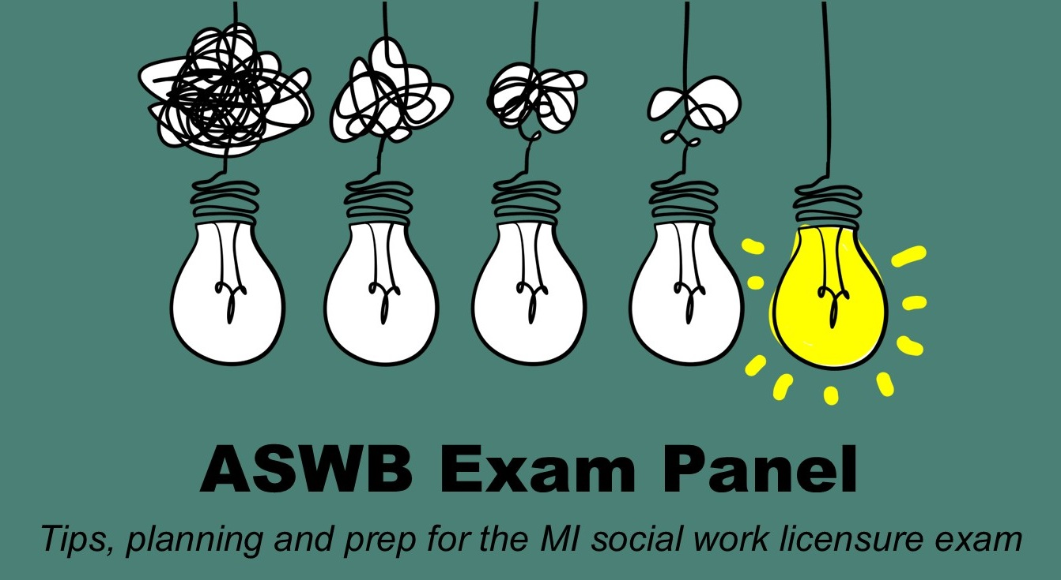
Thursday, June 10, 2020 12:00pm to 1:30pm Zoom Meeting

Slide 2
Resources Offered
Licensure prep exam available CE page
Licensure Mentor Program via Alumni
Notes:
The online computer-based SWES exam is designed to respond to the ASWB social work license exams in all states and can be taken from the comfort of your own home at a time that is convenient to you.

Slide 3
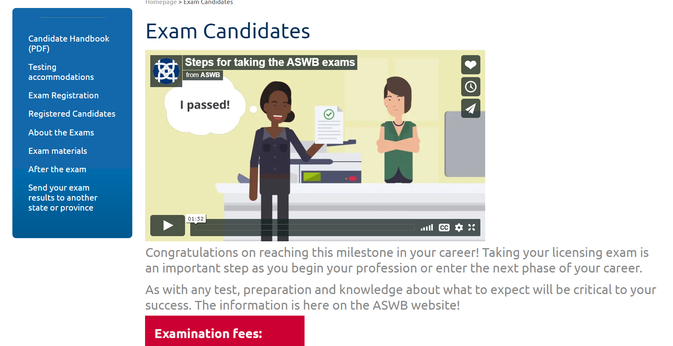
Aswb.org/exam-candidates/
Notes:
Jan – This landing page has a two-minute video that abbreviates “how to get licensed”. This would be a great video to share in your classes, when teaching a capstone course, when doing a field seminar, or as a “gift” to your graduates.
The Candidate Handbook (downloadable for free) has the expanded version of the 10 steps to get licensed. See page 4 of the handbook. Use this resource if you are doing a license prep course! It’s free!

Slide 4
Licensing and Regulatory Affairs

Slide 5
Responsible for creating and deliver the social work licensing exam
A nonprofit association of social work regulatory bodies in the United States and Canada.
Includes 50 states, Washington, D.C., the U.S. Virgin Islands, Guam, the Northern Mariana Islands, and all 10 Canadian provinces
Mission - provide support and services to the social work regulatory community to advance safe, competent, and ethical practices to strengthen public protection
Notes:
Jan
ASWB is one of the 3 pillar associations that collaborated on this Curricular Guide development.
Our members are the regulatory boards throughout North America and the U.S. territories.
The mission of ASWB encompasses support to the social work “regulatory community”. In the broadest sense, social work educators are partners in the regulatory community as we all want to advance safe, competent, and ethical practice.

Slide 6
EXAM Requirement
Will focus on MSW exams
Must pass either the ASWB Clinical Examination or the ASWB Advanced Generalist Examination

Slide 7
ASWB Examinations
Contain 170 multiple choice questions
20 are non-scored items that are being pretested for possible inclusion as a scored question on a future ASWB examination.
only the 150 remaining items will count toward the score.
The pretest and scored items are mixed together on exam

Slide 8
Test items and cognitive ability levels
Types of thinking – or cognitive levels - required to do when answering test questions
Level one: Recall – a description or definition without application to a given situation; requires remembering previously learned material from a broad range of information
Level two: Application - Use of information in a straightforward, specific setting – involves the ability to use learned material in new and concrete situations and may also include the application of rules, methods, concepts, principles, laws or theories
Level three – Reasoning – the ability to use information in a certain context, with more information and options available. Judgement may be used; involve the ability to break material into it’s component parts to understand structure. May also involve identifying the parts, analyzing relationship between the parts and the ability to put parts together to form a new whole

Slide 9
Improving Performance
1) Establish the basic tools needed.
Reading skills – ASWB exams written at 10th grade level (not counting social work terms)
Critical thinking skills – ASWB exams contain questions that require problem-solving and reasoning ability - Differences in recall, application, and reasoning questions
Anxiety management – the reality is that ASWB exams are high-stakes tests (and cost is $260!)

Slide 10
Accountability: Responsibility and Professional Role
Taking responsibility for your license
Be mindful of laws, rules, expectations
Know who you are and the inter-play with who you are working with
Self monitor for capacity to work
Commitment to ongoing professional development – targeted to include knowledge, skills and abilities

Slide 11
Panelists
Sara Berlin, MSW 2020
School Social Worker, Detroit Public Schools Community District
Passed Exam January 19, 2021 - Clinical Exam
Sara’s professional experience is made up of working with children K-12 in multiple settings. Her specialty is children with trauma and emotional impairments. She currently works at a school in Special Education, consisting mostly of social-emotional learning and assessments.
Carolyn Chambers, MSW 2017
Clinical Therapist, Macomb Family Services
Passed Exam November 2018, Clinical
As a clinical social worker, Carolyn has worked in community mental health with adults, inpatient psychiatric with adults and children, and outpatient counseling with adults and children.
Lawrence Robinson Jr., MSW 2018
Academic Advisor II - Wayne State University School of Social Work
Passed the Clinical Social Work Licensure exam on February 3rd, 2021
Since earning my MSW degree in May 2018, my work experience has consisted of counseling university and K-12 students, along with providing psychotherapy services to youth and families.
Jeffrey Williams, MSW 2016
Assistant director of mental health and wellness, University of Tennessee, athletic department.
Passed the exam in November of 2020, clinical
Has gained a great deal of Clinical experience through Community mental health, private practice, and as a school social worker. Provided individual , family, and group therapy to many different populations. currently provides mental health services to college athletes. Received training through Wayne County in the Trauma Focus Cognitive Behavior therapy model.

Slide 12
School Social Worker, Detroit Public School Community District
Sara Berlin

Slide 13
My Plan to Prepare for Exam
Decided how long I wanted to study for prior to taking the test
Pro/Cons of study material available
Found a study group
Identified a personal accountability partner
Created a study schedule

Slide 14
What Worked Well
Set meetings with accountability partner
Positive self-talk and encouragement
Allowing myself extra space near the end of my schedule
Identified a personal accountability partner
Having a set study space
Doing the practice tests as if it were real

Slide 15
What Didn’t Work
Negative talk about my progress
Comparing myself to others and their practice scores
Multiple study resources
Taking away personal time
Not being active, forgetting about social life
Not sticking to my schedule

Slide 16
Best Recommendations
Remember some practice tests won't score you the same as the real one
Take a break when you need to
Everyone is in your corner to help you
Prepare for the exam a couple days prior
Have a meal picked out, drive to the test site, take the day off, have an after-exam plan
You already know most of this, follow your gut the day of the exam

Slide 17
Clinical Therapist, Macomb Family Services
Carolyn Chambers

Slide 18
My Plan to Prepare for Exam
When:
Planned to take exam in November, before holiday season
How:
Took exam prep course in July
Started studying intentionally in August
Spent 1st study session getting comfortable with test prep material, reviewing table of contents, assigning prep content/practice tests/review sessions into separate study weeks
Maintained a flexible study schedule

Slide 19
What Worked Well
Helpful Resources:
ASWB practice exam
WSU SSW Computer Lab practice exams
Quick Study Academic DSM-5 Overview (laminated flip chart)
Free Resources: phone apps, NASW MI Question of the Day
During the Exam:
Choosing an answer, even if unsure, marking it, and coming back to it at the end
Taking a bathroom/eye break
Using provided headphones/earplugs
Using provided whiteboard

Slide 20
What Didn’t Work
The particular weekend exam prep class I chose offered by a competing state university
Wearing jewelry to the exam
Not anticipating test anxiety

Slide 21
Best Recommendations
KNOW YOURSELF!!
Think about logistics!
Consider driving to your test site the day before your exam
Consider asking somebody to drop you off/pick you up
Practice a “dry run”
Positive Affirmations/Motivators:
If they can pass, I can pass.
I am not planning to take this test multiple times.

Slide 22
Academic Advisor WSU School of Social Work
Lawrence Robinson Jr.

Slide 23
My Plan to Prepare for Exam
At First, I had NO Idea
Where, What topics, How much depth, How long
I Joined the SW Mentor Program
It gave me Community, and Hope
Mentors (Ashley/Austin)
I Asked Questions. EX: LCSW Exam
Gathered Resources
(Youtube, Exam Guide, Pocket Prep, Talked with Friends, Got their Notes, PassItPro, TDC )

Slide 24
What Worked Well
Having a program that was proven to work
Therapist Development Center
Having a plan with structure
What, When, How to study
Pre-Test, Quizes, Work Sheets, Audio Lecture, Two ½ Mock, 2 Full Mock Exams
Study Partner
Accountability (Twice a WK to four, Pep Talks)
Morning & Evening Session from 7 – 8am & 9pm - 10pm
Support from Family
Shoutouts to my wife and daughter for allowing me the peace of mind/time to study. Hardy/Healthy Meals leading up to exam

Slide 25
What Didn’t Work
Using Multiple Exam Resources at Once
ASWB Pocket Prep (Caution)
Quizlet
Random Youtube Videos
Keeping Myy Schedule Over the Holiday Breaks. Don't Beat Yourself Up.
Taking Fruit into the Testing Sight

Slide 26
Best Recommendations
Trust the process
75% is for sure passing.
73% on first full mock (126 of 170)
I took the whole 4 hours for my first mock exam
72% on 2nd Full Mock (125 of 170)
2nd Exam I finished 35 min early, changed my answers
71% on SSW exam
Questions were super wordy, I almost wanted to give up
114 of 170 on exam. I needed 103 Question Correct
Review Code of Ethics Days Leading Up to Exam
Take at a 10-Minute Break during Exam (Q 85)

Slide 27
Assistant Director of Mental Health and Wellness (Athletic Department)
Jeffrey Williams

Slide 28
My Plan to Prepare for Exam
Passitpro.com
Review NASW Code of Ethics
Practice Exams
Therapy to address self-sabotaging behaviors

Slide 29
What Worked Well
Studying for short periods of times (45mins).
Studying a minimum of 3 times a week.
Answering questions (not just reviewing material)
Listening to videos on (YouTube) (content areas that you may not be as strong in).
Mindfulness

Slide 30
What Didn’t Work
Studying for long periods of time.
Paying for tutors.
Reviewing a lot of information for long periods of time
Reading books about the exam.
Studying in groups.

Slide 31
Best Recommendations
Passitpro.com
Therapy for self-sabotaging behaviors
Belief that you are able! ( The Exam is not trying to trick you).
Never give up!

Slide 32
ASWB Exam

Slide 33
Digital $15 Paper copy $20
Tips on preparing for the exam
Exam development process
Exam Content Outlines & References
Exam Administration Process
Notes:
Nancy - This Guide a great resource for taking the social work high stakes exams and knowing how to plan your study prep.
ASWB Guide provides:
Tips on how to prepare for the exam
Explanation of how the exam questions are constructed
A couple sample exam questions from retired exams
Recall questions & rationale
Application questions & rationale
Reasoning questions ^ rationale
Lists the KSA’s (also available free on ASWB.org)
List of study materials/resources that have relevant information contained in the exams.

Slide 34
ASWB “Suite” of Exam Resources
Candidate Handbook
Free download from ASWB.org website
Guide to the Social Work Exams
($20/$15 e-book)
Exam content outlines Free download aswb.org
organized by % of knowledge, skills, and abilities (KSAs) on exam
Individual Practice Exams ($85)
Notes:
Nancy – Access these resources from ASWB.org.

Slide 35
Resources From 2020 Panelists
Brooke Rodriguez, LMMSW (may need library access)
https://elibrary.wayne.edu/record=b5400519~S47
https://ebookcentral.proquest.com/lib/wayne/detail.action?docID=5108153\
LaKeidra Bronner,
Pocket Prep (ASWB LCSW)
AATBS (https://aatbs.com/social-work-clinical-exam-prep-package-self-study)
Facebook groups: LMSW/LCSW Study Groups (https://www.facebook.com/groups/125915564815604), Black Therapists Rock (https://www.facebook.com/groups/btrdc) , Black Girls in Social Work (https://www.facebook.com/groups/2100003930221912)
Phil Luttrell Youtube Channel (https://www.youtube.com/channel/UCN3MVOyj9uS5x_Npghc9dYg)
Elaina Brown, LMSW
https://www.aswb.org/wp-content/uploads/2017/04/2018-Clinical.df
https://www.pocketprep.com/exams/aswb-lcsw/
https://www.facebook.com/passitpro/
https://forms.wayne.edu/570289c2a6e90
Aubrey Gilliland, LMSW
ASWB generalist exam guide
ASWB generalist practice exam
DSM-5 quick overview guide

