Slide 1
Student Tutorial
Intern Placement Tracking (IPT) at the Wayne State University
School of Social Work –
Office of Field Education
Notes:
This tutorial will walk you through our office’s online field placement database system, called “Intern Placement Tracking” or “IPT” for short. The system allows field instructors, students, their assigned Faculty Advisors, and our office to log into the same web-based database, make placement matches between students and agencies, submit and review assignments, contact one another, and much more.
This tutorial is self-directed, so if it is your first time, we recommend going through the pages in order, but you are always welcome to skip around the different pages in any order you like. If you have any questions regarding the material here, feel free to contact our office by phone or email at 313.577.4446 or field_education@wayne.edu. All of this information is available on our website at socialwork.wayne.edu.

Slide 2
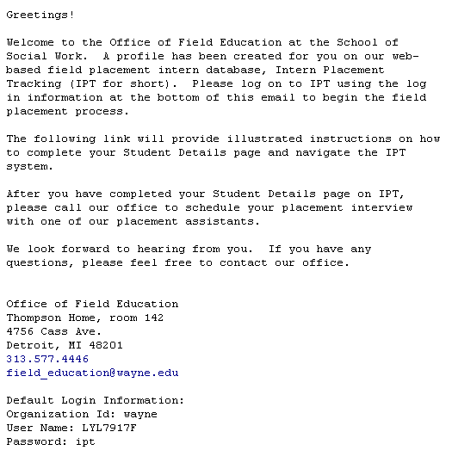
Log on to IPT: Your default information
Introduction Email
This email is sent to your WSU email address. You can forward emails from your WSU account to another that you check more regularly by adjusting your account settings in Pipeline.
Notes:
When we begin the placement process for the upcoming semester of placements, you will receive an email like this one instructing you to log in and fill out your student profile on IPT. The email will go to your Wayne State email address, as will ALL email correspondence from our office, so make sure you check this email account regularly. We will not send emails to an alternative email address. When you receive you IPT introduction email, take special notice of the default log in information on the bottom of the page, circled in red here.

Slide 3
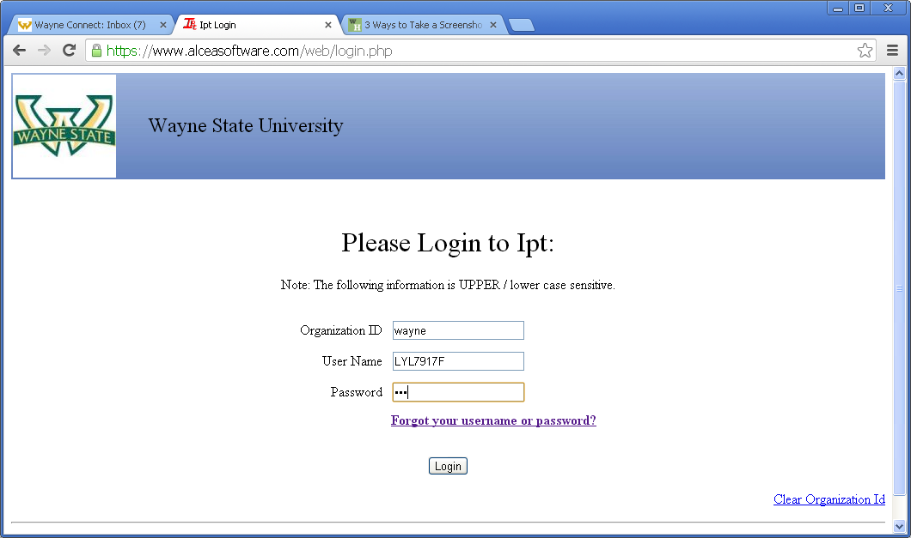
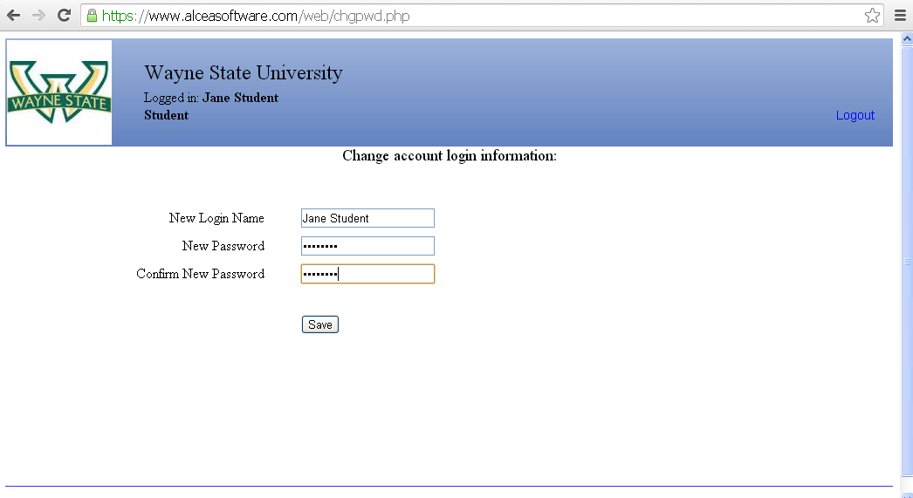
Log in to IPT
Go to www.runipt.com.
Log in to IPT using the log in information provided in the email.
Create a new login name and a new password for yourself.
Notes:
On your web browser, go to runipt.com and use the default log in information we provided. You will automatically be directed to created your own log in name and your own password. The log in name is case sensitive, and it allows spaces, numbers, and special characters like exclamations points and percentage signs. If you ever forget your password or log in name, don’t worry – simply call or email our office and we’ll reset it back to that same default log in information. You’ll get an email notification, and you can start this log in process all over again. You won’t lose any data in your account if this happens.

Slide 4
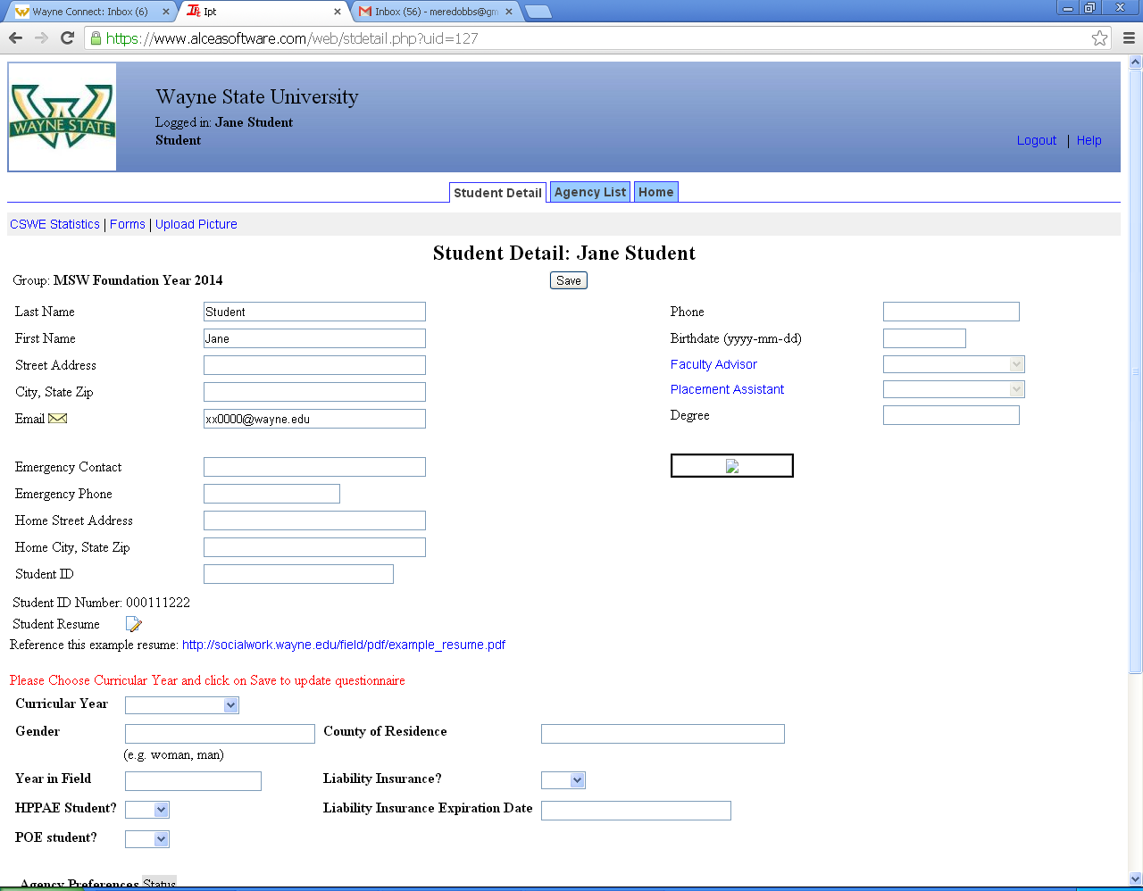
Student Detail Page
Notes:
When you log in to IPT, you will arrive at your Student Detail Page. The four highlighted boxes are information we have already filled in for you. You will not be able to edit these fields – if there is an error or a change, please contact our office and we will make the change for you. Note that you must use your Wayne State access ID email address. We can correct mistakes, but we cannot insert a different email address.
Also, notice the “Save” button circled in red – you MUST click “save” after every change you make. The system will NOT prompt you to save when you leave the page. You should get in the habit of saving frequently. The next page focuses on data in the bottom left hand corner.

Slide 5
Student Detail Page (continued)
Upload your Field Education Resume here.
Upload your Field Education Resume here.
Use this example as a reference.
Use this example as a reference.
First, choose your curricular year.
Then, when you click save., your detail page will update itself, revealing new data fields to fill out.
Notes:
This is a close-up view of part of the student detail page. Starting with the top annotation, there is a data field on the detail page where you can upload your resume. You cannot be referred without your educational resume on file, so make sure you upload yours when you complete your detail page. Click on the icon to upload. Immediately below the upload icon is a link to view the example resume on our website. Reference this as you work on your resume.
Below the resume questions is a line of instructions in red telling you to choose a curricular year. Your curricular year will be indicated in your introduction email, so check there to make sure you choose the correct option. Once you choose a curricular year and click SAVE (found at the top of the page), your student detail page will update itself, revealing new data fields that must be filled out.

Slide 6
Agency List
Start by clicking the Agency List tab.
If no agencies are listed, click A-Z to see all agencies
Browse through the agencies to find one that you like. Click on it.
Notes:
After filling out your detail page, you should browse through the Agency List to familiarize yourself with the placement opportunities available. At the top of the student detail page is a group of three tabs. Click SAVE to save any changes to you student detail page, then click on the agency list tab, here circled in red, to browse agencies for your placement.
The agency list tab will take you to an alphabetical list of our agencies. Click A to Z to view all the agencies. Browse through the list to find agencies that interest you.

Slide 7
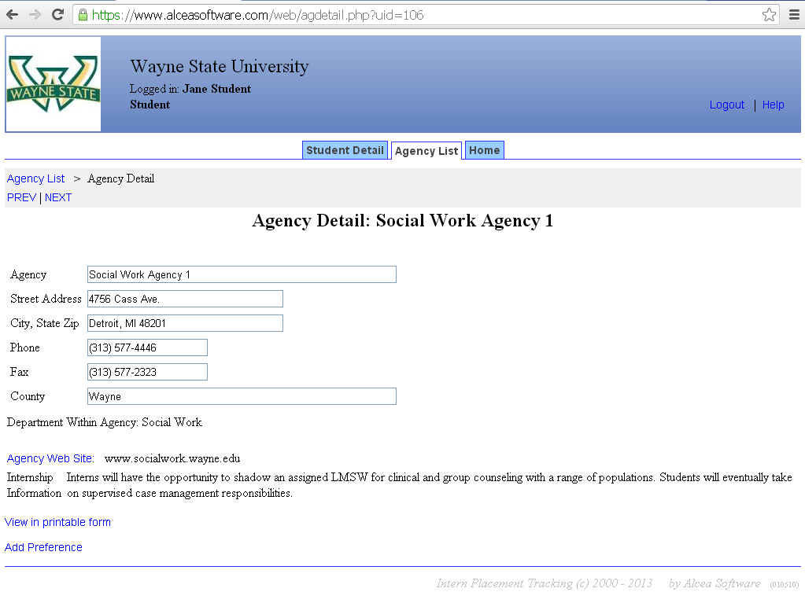
Agency Detail Page: picking preferences
Read the internship information to see if this agency interests you.
Basic agency info is listed here.
Click Add Preference to list this agency as one of your preferences. You will be redirected to your Student Detail page.
Notes:
This is the agency detail page. You can find basic information about the agency, and you should pay special attention to the “Internship Information” section to determine if the internship interests you. If it does, click the “Add Preference” link, indicated here by a red arrow. Clicking this link will redirect you to your Student Detail Page.

Slide 8
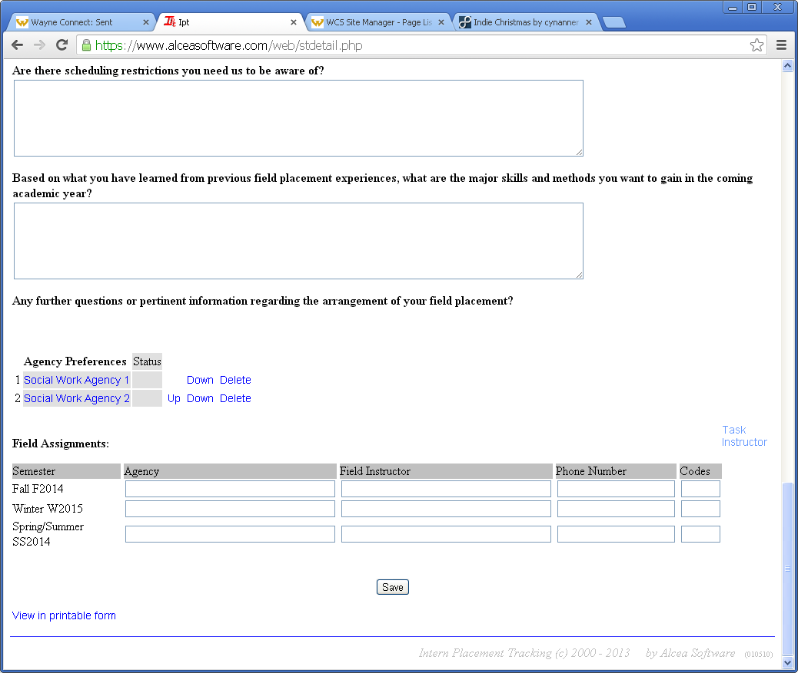
Agency Preferences
Scroll down to find your agency preferences listed here.
You can change the order or delete your preferences.
Notes:
If you scroll down to the bottom of your student detail page, you will see the “Agency Preferences” section. This is where your chosen preferences will be listed, and you can rank them in order of interest by using the “up” and “down” links. You should choose around one to three preferences.

Slide 9
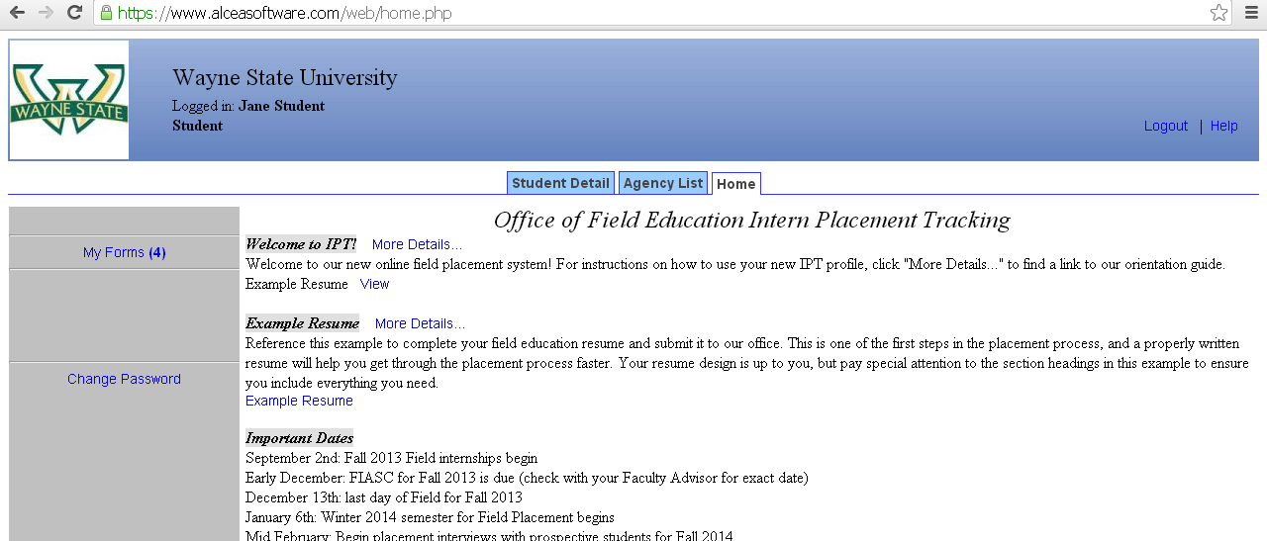
Home
Click on the Home tab.
You can change your password at any time.
Important Information and updates are listed here, in the Bulletin section.
Here you can access all of your assignments to complete and evaluations to review.
Notes:
To see your Home page, click on the HOME tab on top. The Bulletin section in the middle lists important information, updates, and reminders if there are any. On the bottom left, there is a link to change your password, which you can alter at any time, and on the top left is a link to “My Forms” page, where you can access all of your assignments and evaluations.

Slide 10
Forms
Documents supported by IPT that are completed by the student and the field instructor.
Notes:
This section of the tutorial will walk you through each of the “forms” or documents that you will see over the course of the internship. You may wish to save this section for when you actually begin an internship, because you will not see these documents until the placement starts. It’s also helpful to review these instructions before beginning each new form for the first time. You can skip directly to the form you need direction for.

Slide 11
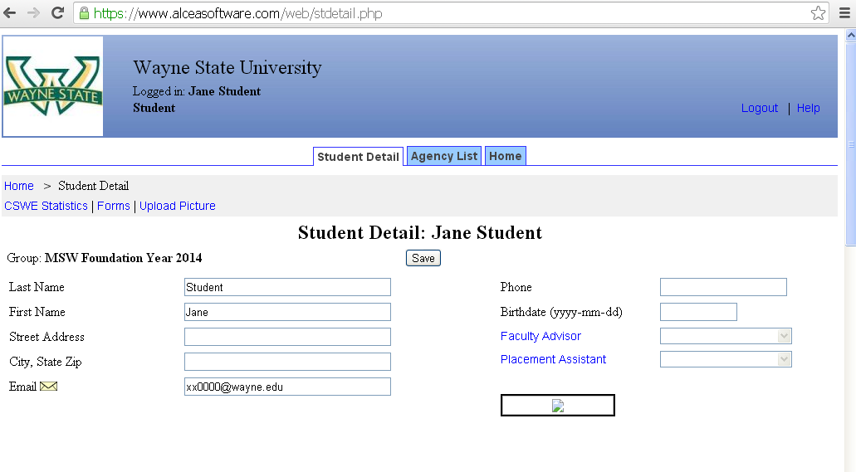
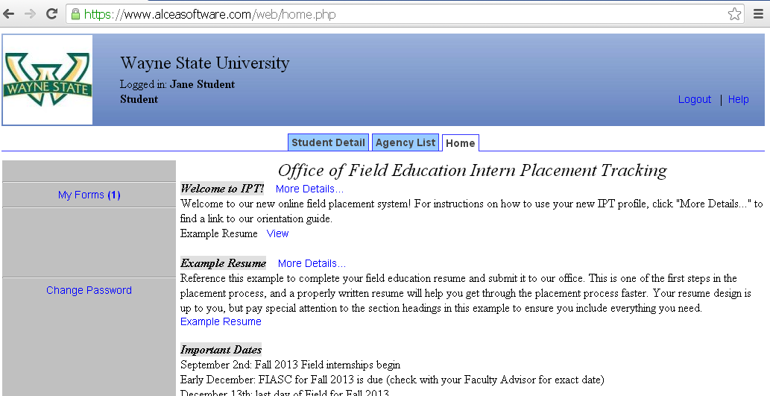
Forms: two ways to access
1) Go to your Student Detail Page. Click the Forms link.
2) Go to your Home page. Click My Forms.
When you have forms to complete, there will be a number here as a reminder.
Notes:
There are two ways to access your forms. On your detail page, there is a link to “FORMS” on the top left hand side. This is link is circled in red. Alternatively, you can click the HOME tab on the top bar and choose the “My Forms” link on the top left hand side. This link is also circled in red.

Slide 12
Form List
You will receive an email notification when you have new forms to complete.
Click here to view and complete the assigned form
The document Status column tells you if the form is new, has been started, or is completed.
Forms require multiple signers. These columns tell you who still needs to sign.
Check this box to hide forms you have already completed.
The due dates tell you when to complete and sign to submit your form.
Notes:
This is your “Form List”. It shows what forms you have been assigned to complete. You will receive an email notification every time a new form is assigned to you. I’ll start from the bottom left and work across the page. On the left side of the list, is the VIEW column, which allows you to view the form. Simply click on the blue word “view” to open the form in a new window. Immediately above the VIEW column is a tick box that allows you to hide completed forms. This is helpful to keep track of forms as you move through the semester, especially with forms that must be completed multiple times, like Process Recordings.
In the middle of the list is the name of the form, a little further to the right is the STATUS column. If the form has never been viewed, it will appear as “new”. If you have viewed it but not submitted it, it will be marked as “active”. After you electronically sign and submit the form, it will be marked as “complete”. Just to the right of the status column, you can see the SIGNED and WAITING FOR columns. Because the forms require multiple signers – the student, field instructor, and Faculty Advisor – you need a column to indicate who is next in line to sign and submit the form. This is also indicated in the STATUS column by two asterisks: if you see two asterisks by the status, it means that others are waiting on YOU to sign and submit the form. And lastly, on the far right side of the column is the Due Date by which you must sign and submit your form.

Slide 13
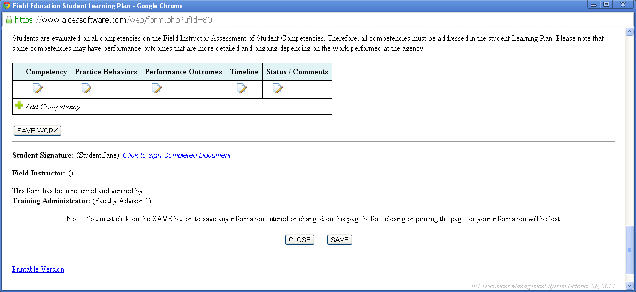
Learning Plan
Fill out the information at the top of the page, then scroll down.
The middle section of the page details the eleven core competencies. Follow these when writing your learning plan.
Click on the B icon to add a response (the text field will open in a new window – click o before closing)
Click here to add another core competency. You must include ALL eleven competencies.
Click to sign and submit.
You can save the document and return to it at any time.
Notes:
The learning plan is completed by the student with the field instructor’s input. It should be done within the first month of placement. You will be the first signer of the form, so you will have to submit the form before your field instructor can see your work. Once you do sign and submit, your answers will be locked and your field instructor will be able to review your form and write comments on your answers. The learning plan is considered a “living document”, meaning it should be revisited and amended as necessary throughout the internship. It may also need to be amended after the Midterm Evaluation if concerns are identified. To make changes consult with your field instructor and then contact your Faculty Advisor to have the signatures removed allow the form to be edited.
Included here is the top of the form, which you fill out, then we have skipped the middle section that details the eleven core competencies. Your learning plan should follow them closely, and you must include all eleven competencies. At the bottom of the page is the table in which answers are submitted. When you fill out the form, click on the icon in each box to edit the text. When you have finished, you should sign and submit the document, which allows your field instructor to view your work. Remember, you can and should save the document at any time, by clicking a SAVE or SAVE WORK button, which here are circled in red.

Slide 14
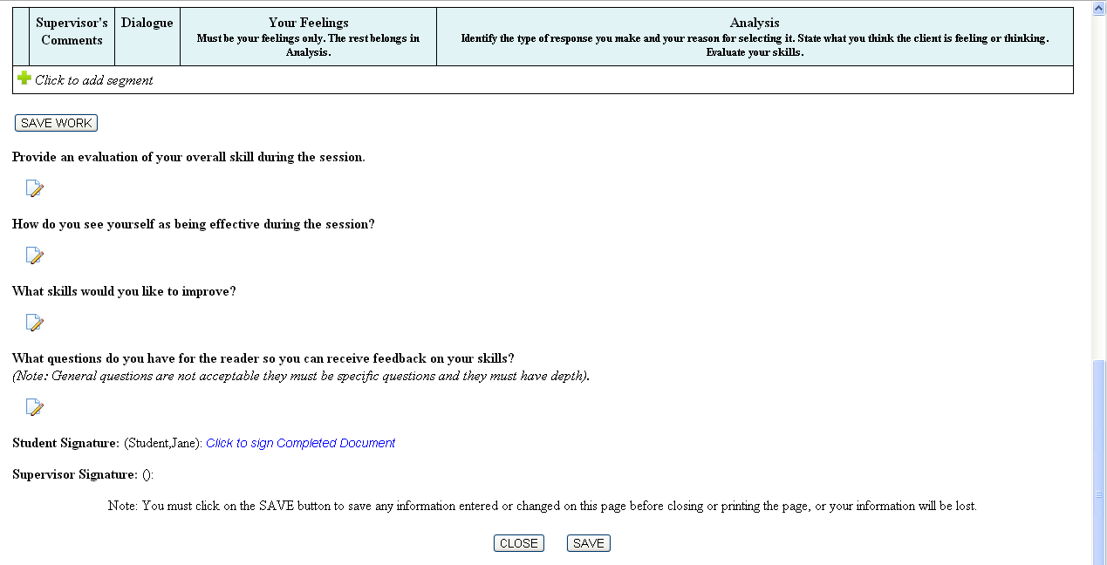
Process Recording
Fill in your details, then scroll down the page.
The middle section of the page gives directions for your Process Recording. Reference the example on our website for more direction.
Click here to add a segment. The Supervisor’s Comments column is completed by your field instructor.
Click on the B icon to add a response (the text field will open in a new window – click o before closing)
You can save the document and return to it at any time.
Click to sign and submit.
Notes:
Process Recordings are completed by the student and reviewed by the field instructor. Students must complete multiple process recordings each semester, so each assigned form will have its own distinct due date. You will be the first signer of the form, so you will have to start each form before your field instructor can view it.
Included here is the top of the form, which you fill out, then we have skipped the middle section that gives directions on how to complete a process recording. You should read them closely, and you should reference the instructions and example on our website. A link is include on this page. At the bottom of the page is the table in which answers can be submitted. You should fill out three columns on the right: “Dialogue”, “Your Feelings”, and “Analysis”. The system will require you to fill in every text field. When you have finished the document, you should sign and submit so your field instructor can review your work. You will be able to modify the form even after submission, so your field instructor may assign you to augment or rewrite parts of process recording. Remember, you can and should save the document at any time, by clicking a SAVE or SAVE WORK button, which here are circled in red.

Slide 15
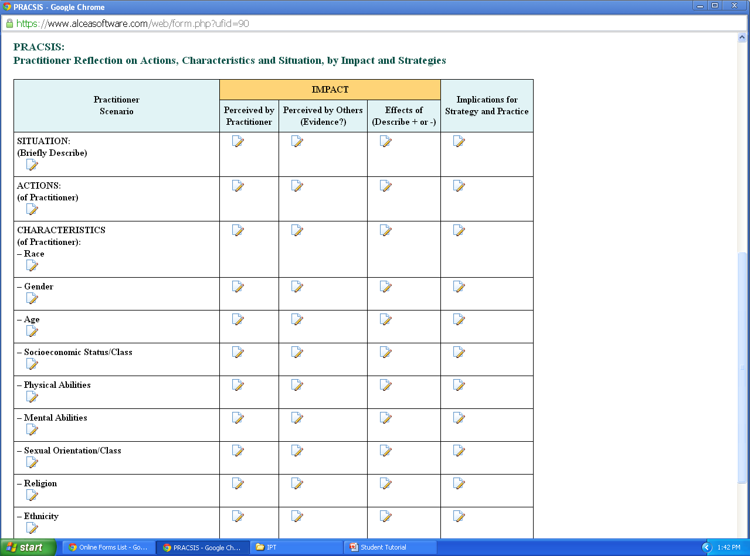
PRACSIS (for ICPL students only)
Fill in your details, then scroll down the page.
The middle section of the page gives directions for your PRACSIS. Reference the example on our website for more direction.
Click on the B icon to add a response (the text field will open in a new window – click o before closing)
Click to sign and submit.
You can save the document and return to it at any time.
Notes:
PRACSIS are completed by the student and reviewed by the field instructor. Students must complete multiple PRACSIS each semester, so each assigned form will have its own specific due date. You will be the first signer of the form, so you will have to start each form before your field instructor can view it.
Included here is the top of the form, which you fill out, then we have skipped the middle section that gives directions on how to complete a PRACSIS. You should read them closely, and you should reference the instructions and example on our website. A link is include on this page. At the bottom of the page is the table in which answers can be submitted. The system will require you to fill in every text field in the table, even if that means writing “not applicable” or “no opportunity”. When you have finished the document, you should sign and submit so your field instructor can review your work. You will be able to modify the form even after submission, so your field instructor may assign you to augment or rewrite parts of process recording. Remember, you can and should save the document at any time, by clicking a SAVE or SAVE WORK button, which here are circled in red.

Slide 16
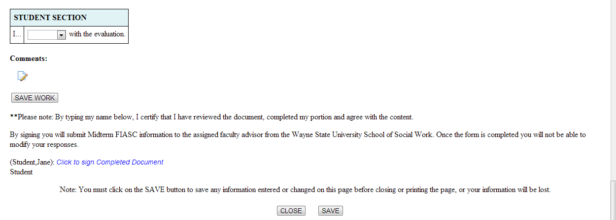
Midterm Evaluation
After your Field Instructor completes your Midterm Evaluation…
Scroll down to read through the evaluation.
Choose AGREE or DISAGREE from the dropdown menu.
If you chose DISAGREE, explain why. If you AGREE, write “No comment.”
Click to sign and submit.
You can save the document and return to it at any time.
Notes:
The Midterm Evaluation is completed by the field instructor, then signed in acknowledgment by the student. It should be done around six or seven weeks into the semester, and it will have a specific due date. Your field instructor is the first signer of the form, so he or she has to finish the form before you can view it. Once your field instructor signs and submits, you can review the evaluation, sign in acknowledgment, and leave a statement of agreement or disagreement. You will NOT be able to modify your statement after submission, so be careful and submit only when you are finished.
Included here is the top of the form, which your field instructor will fill out, then we have skipped the middle section that includes the bulk of the questions. Your field instructor will complete all answers in the evaluation. At the bottom of the page is a blue box where your field instructor makes an overall recommendation. There is a space below where they might leave some comments about your progress. When you have reviewed the evaluation, sign and submit. Remember, you can and should save the document at any time, by clicking a SAVE or SAVE WORK button, which here are circled in red.

Slide 17
FIASC: Field Instructor Assessment of Student Competencies
After your Field Instructor completes your FIASC…
Scroll down to read through the evaluation. This is a large factor in your semester grade.
Click to sign Completed Document
If you have any concerns about the material in your evaluation, contact your faculty advisor.
Click to sign and submit.
Notes:
FIASC is the acronym for Field Instructor Assessment of Student Competencies. It is our end-of-semester evaluation of student performance, and it is completed by the field instructor, then signed in acknowledgment by the student. It will be assigned about a month before the end of the semester to give field instructors time to review and complete it, but it should not be submitted until near the end of the semester. It will have a specific due date. Your field instructor will be the first signer of the form, so he or she has to complete the form, sign, and submit before you can review it and sign in acknowledgment. Any disagreements you may have with you evaluation should be directed to your Faculty Advisor.
Included here is the top of the form, then we have skipped the middle section that includes the bulk of the questions. The Evaluation is organized by the eleven core competencies, and we have included one of these eleven sections for you to see. Each sections has a series of behaviors related to the that competency, and your field instructor ranks your proficiency on each behavior. The sections also have a comments portion to further explain the proficiencies indicated.
At the bottom of the page there is a link for you to sign and submit the document. The signature box will pop up, outlined in blue. When you have finished reviewing the evaluation, you should sign and submit the form. There is nothing you must fill out or answer, so your signature is simply a required acknowledgment. (You cannot receive a final semester grade unless you sign.) You will be able to view the form even after signing.

